Slide 1
Object Oriented Software Engineering (OOSE)
22CS017
Software Risk Management

Slide 2
Index
What is Risk
What are Software Risks
Software Risk Categorization
Risk Management and Planning
Risk Identification
Risk Projection
Risk Mitigation
Monitoring and Management (RMMM) plan
Practice Questions

Slide 3
Risk Definition
Risk is the probability of suffering loss. Risk provides an opportunity to develop the project better.
There is a difference between a Problem and Risk.
Problem is some event which has already occurred but risk is something that is unpredictable. Risk is an expectation of loss, a potential problem that may or may not occur in the future.
It is generally caused due to lack of information, control or time.

Slide 4
Software Risk
A possibility of suffering from loss in software development process is called a software risk.
Loss can be anything, increase in production cost, development of poor quality software, not being able to complete the project on time.
Software risk exists because the future is uncertain and there are many known and unknown things that cannot be incorporated in the project plan.
A software risk can be of two types
(1) internal risks that are within the control of the project manager
(2) external risks that are beyond the control of project manager.

Slide 5
Software Risk Categorization
1. Project risks threaten the project plan. That is, if project risks become real, it is likely that the project schedule will slip and that costs will increase.
Project risks identify potential budgetary, schedule, personnel (staffing and organization), resource, stakeholder, and requirements problems and their impact on a software project.
2. Technical risks threaten the quality and timeliness of the software to be produced. If a technical risk becomes a reality, implementation may become difficult or impossible.
Technical risks identify potential design, implementation, interface, verification, and maintenance problems.

Slide 6
Software Risk Categorization
3. Business risks threaten the viability of the software to be built and often jeopardize the project or the product. Candidates for the top five business risks are:
building an excellent product or system that no one really wants (market risk)
building a product that no longer fits into the overall business strategy for the company (strategic risk)
building a product that the sales force doesn’t understand how to sell (sales risk)
losing the support of senior management due to a change in focus or a change in people (management risk)
losing budgetary or personnel commitment (budget risks).

Slide 7
Software Risk Categorization
Another general categorization of risks has been proposed by Charette:
Known risks are those that can be uncovered after careful evaluation of the project plan, the business and technical environment in which the project is being developed, and other reliable information sources (e.g., unrealistic delivery date, lack of documented requirements or software scope, poor development environment).
Predictable risks are extrapolated from past project experience (e.g., staff turnover, poor communication with the customer, dilution of staff effort as ongoing maintenance requests are serviced).
Unpredictable risks are the joker in the deck. They can and do occur, but they are extremely difficult to identify in advance.

Slide 8
Risk Strategies
Reactive risk strategies:
The majority of software teams and managers rely on this approach
Nothing is done about risks until something goes wrong
The team then flies into action in an attempt to correct the problem rapidly (fire fighting mode)
Crisis management is the choice of management techniques
Proactive risk strategies:
A proactive strategy begins long before technical work is initiated.
Potential risks are identified, their probability and impact are assessed, and they are ranked by importance.
Primary objective is to avoid risk and to have a contingency plan in place to handle unavoidable risks in a controlled and effective manner.

Slide 9
Risk Identification
Risk identification is a systematic attempt to specify threats to the project plan
By identifying known and predictable risks, the project manager takes a first step toward avoiding them when possible and controlling them when necessary
There are two distinct types of risks: generic risks and product-specific risks.
_{Generic risks}
Risks that are a potential threat to every software project
_{Product-specific risks}
Risks that can be identified only by those a with a clear understanding of the technology, the people, and the environment that is specific to the software that is to be built
This requires examination of the project plan and the statement of scope
"What special characteristics of this product may threaten our project plan?"

Slide 10
Risk Identification
One method for identifying risks is to create a risk item checklist. The checklist can be used for risk identification and focuses on some subset of known and predictable risks in the following generic subcategories:
Product size—risks associated with the overall size of the software to be built or modified.
Business impact—risks associated with constraints imposed by management or the marketplace.
Stakeholder characteristics—risks associated with the sophistication of the stakeholders and the developer’s ability to communicate with stakeholders in a timely manner.

Slide 11
Risk Identification
Process definition—risks associated with the degree to which the software process has been defined and is followed by the development organization.
Development environment—risks associated with the availability and quality of the tools to be used to build the product.
Technology to be built—risks associated with the complexity of the system to be built and the “newness” of the technology that is packaged by the system.
Staff size and experience—risks associated with the overall technical and project experience of the software engineers who will do the work.

Slide 12
Risk Projection
Risk projection, also called risk estimation, attempts to rate each risk in two ways—
the likelihood or probability that the risk is real and
the consequences of the problems associated with the risk, should it occur.
You work along with other managers and technical staff to perform four risk projection steps:
Establish a scale that reflects the perceived likelihood of a risk.
Delineate the consequences of the risk.
Estimate the impact of the risk on the project and the product.
Assess the overall accuracy of the risk projection so that there will be no misunderstandings.

Slide 13
Risk Mitigation
All of the risk analysis activities presented to this point have a single goal—to assist the project team in developing a strategy for dealing with risk.
An effective strategy must consider three issues: risk mitigation, risk monitoring, and risk management and contingency planning.
If a software team adopts a proactive approach to risk, avoidance is always the best strategy. This is achieved by developing a plan for risk mitigation.
To mitigate this risk, you would develop a strategy for reducing turnover. Among the possible steps to be taken are:
Meet with current staff to determine causes for turnover (e.g., poor working conditions, low pay, competitive job market).
Mitigate those causes that are under your control before the project starts.

Slide 14
Risk Mitigation
Once the project commences, assume turnover will occur and develop techniques to ensure continuity when people leave.
Organize project teams so that information about each development activity is widely dispersed.
Define work product standards and establish mechanisms to be sure that all models and documents are developed in a timely manner.
Conduct peer reviews of all work (so that more than one person is “up to speed”).
Assign a backup staff member for every critical technologist.

Slide 15
Risk Monitoring
As the project proceeds, risk-monitoring activities commence.
The project manager monitors factors that may provide an indication of whether the risk is becoming more or less likely.
In the case of high staff turnover, the general attitude of team members based on project pressures, the degree to which the team has jelled, interpersonal relationships among team members, potential problems with compensation and benefits, and the availability of jobs within the company and outside it are all monitored.
In addition to monitoring these factors, a project manager should monitor the effectiveness of risk mitigation steps.

Slide 16
Risk Management and Planning
Risk management and contingency planning assumes that mitigation efforts have failed and that the risk has become a reality.
Continuing the example, the project is well under way and a number of people announce that they will be leaving. If the mitigation strategy has been followed, backup is available, information is documented, and knowledge has been dispersed across the team.
In addition, you can temporarily refocus resources (and readjust the project schedule) to those functions that are fully staffed, enabling newcomers who must be added to the team to “get up to speed.”
Those individuals who are leaving are asked to stop all work and spend their last weeks in “knowledge transfer mode.”
This might include video-based knowledge capture, the development of “commentary documents or Wikis,” and/or meeting with other team members who will remain on the project.

Slide 17
RMMM Plan
The risk mitigation, monitoring, and management (RMMM) plan may be a part of the software development plan or may be a separate document
Once RMMM has been documented and the project has begun, the risk mitigation, and monitoring steps begin
Risk mitigation is a problem avoidance activity
Risk monitoring is a project tracking activity
Risk monitoring has three objectives
To assess whether predicted risks do, in fact, occur
To ensure that risk aversion steps defined for the risk are being properly applied
To collect information that can be used for future risk analysis

Slide 18
RMMM Plan
The findings from risk monitoring may allow the project manager to ascertain what risks caused which problems throughout the project
Some software teams do not develop a formal RMMM document. Rather, each risk is documented individually using a risk information sheet (RIS).
In most cases, the RIS is maintained using a database system so that creation and information entry, priority ordering, searches, and other analysis may be accomplished easily.
Once RMMM has been documented and the project has begun, risk mitigation and monitoring steps commence.

Slide 19
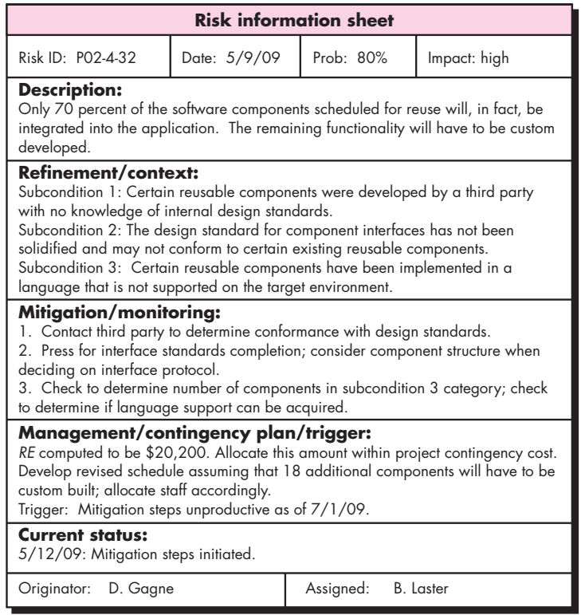
RMMM Plan – RIS Example

Slide 20
Practice Questions
Can you describe the steps involved in the risk management process?
How would you priorities risks in a project?
What techniques do you use for risk identification?
How would you assess the potential impact of a risk?
Can you explain what risk appetite is?
How do you communicate risk-related information to stakeholders?
an you explain the importance of staying updated on the risk management trends and best practices?
Can you explain Risk Management and why it is important for organizations?

